Slide 1
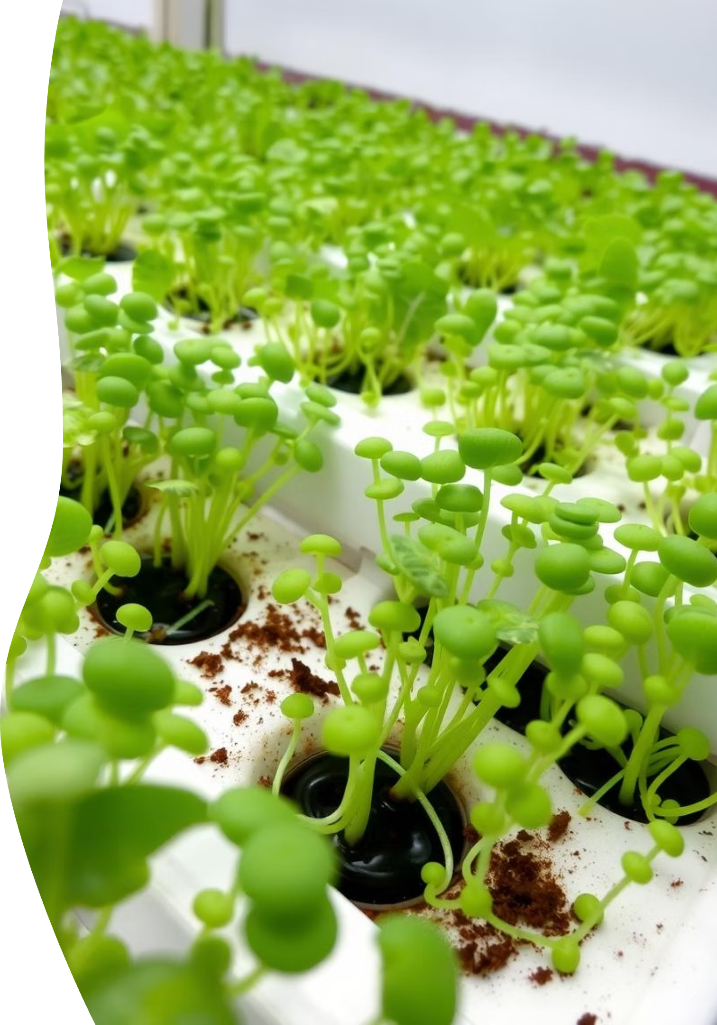
Title: Hydroponic Cattle Feed Generation System
Sheikh Ata Ur Rehman Saqib FA22-BCE-061
Syed Iftikhar Shah FA22-BCE-057
Sahibzada Daniyal FA22-BCE-082
Supervisor: Sir Naveed Shaikh
Date: 20 July, 2025

Slide 2
Automated Hydroponic Cattle Feed Generator
Full Automation: Automates all aspects of fodder growth, from watering to environmental control.
Optimized Resource Use: Achieves high efficiency in water and nutrient consumption through recirculation.
Accelerated Crop Growth: Provides a controlled environment that promotes rapid and consistent fodder production.
Smart Monitoring & Control: Utilizes integrated sensors and actuators for continuous oversight and automated adjustments.
High-Density Cultivation: Maximizes fodder yield in minimal space, enabling efficient and scalable production.

Slide 3

Project Overview
Autonomous Fodder Production
Goal
Core
Develop a fully automatic hydroponic cattle feed generation system.
Autonomous management of fodder growth in a multi-tray setup.
Control
PIC18F452 microcontroller, programmed entirely in assembly language.

Slide 4

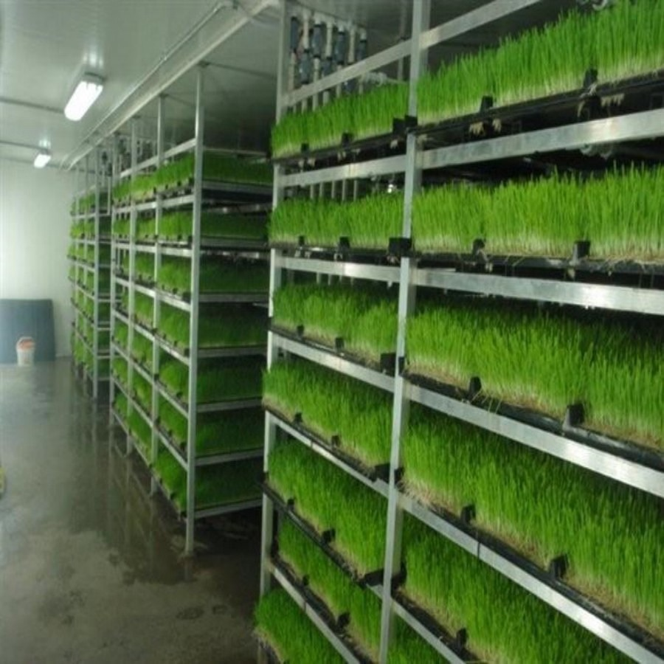
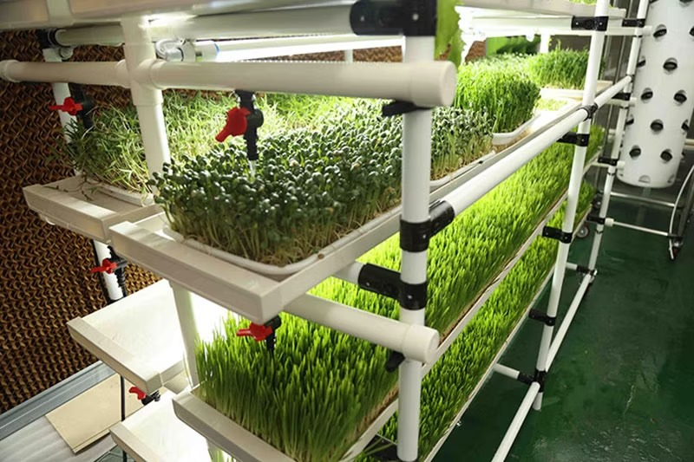

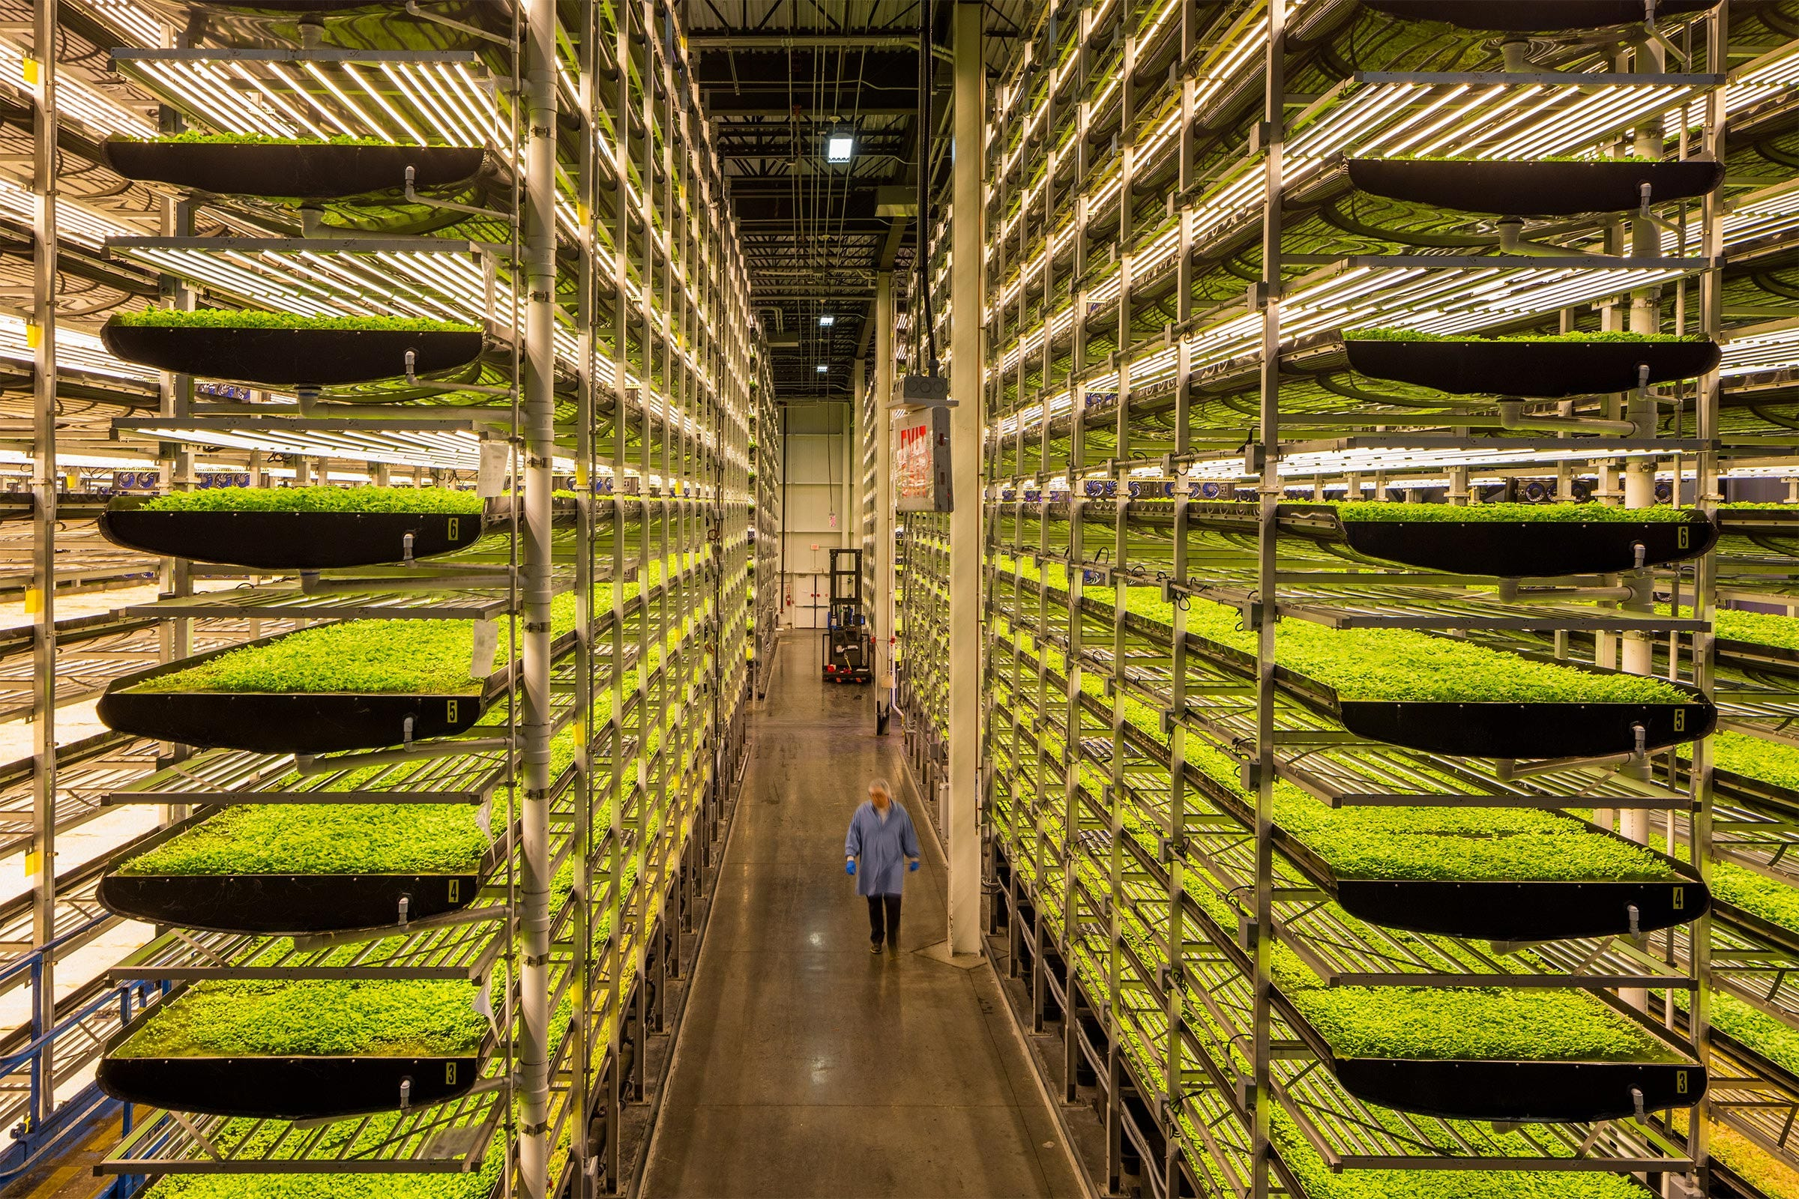


Motivation
Why Automated Hydroponics?
Consistent Supply
Ensuring a year-round source of fresh, high-quality cattle fodder.
Farm Efficiency
Reducing manual labor and improving overall farm productivity.
Sustainable Practices
Promoting water efficiency, reduced land use, and localized food production.

Slide 5
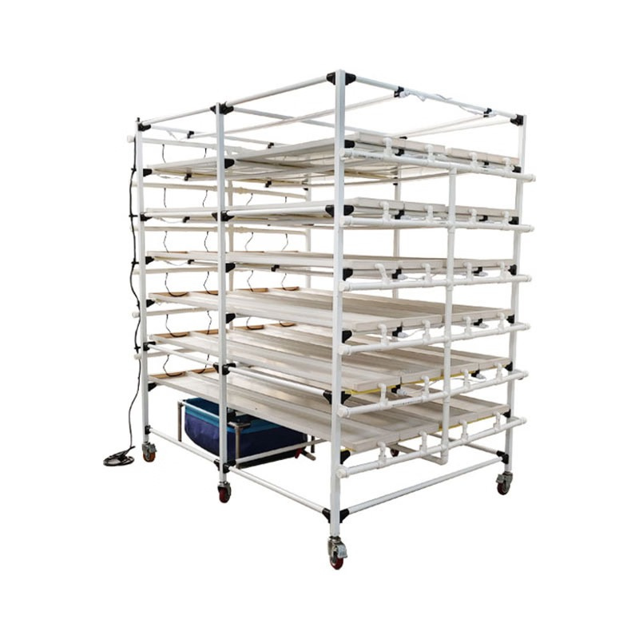
System Design
Key Components & Interfaces:
PIC18F452 Microcontroller: Central Processing Unit, manages sensor inputs
and actuator outputs.
Power Supply: Batteries have been used.
Sensors: Water level, tray position, and optional RTC for precise timing.
Actuators: Water pump (DC Motor), Stepper Motor for tray shifting.
Displays: LCD for real-time status, LEDs for visual cues.

Slide 6
Software/Hardware Model
PIC18F452 Microcontroller
Sensors & Actuators
Assembly code execution.
Float switch or conductive probes for water level sensing.
Peripheral control and state machine management.
Digital I/O for sensors and actuators.
Limit switches for tray position detection.
Timer Modules for precision timing.
Relay/MOSFET controlled DC motor for water pump.
ADC for analog sensor readings.
Stepper motor with driver IC for tray shifting.
Interrupt Controller for event handling.
LCD display for system status messages.

Slide 7


Societal & Environmental Impact
Societal
Consistent, high-quality fodder supply.
Reduced manual labor.
Improved farm efficiency.
Environmental
Efficient water usage.
Reduced land use.
Localized production.
Reduced pesticide use.

Slide 8
Anticipated Results & Timeline
Expected Outcomes
Key Project Phases
Fully functional hydroponic system prototype.
Phase 1: Research & Design.
Autonomous operation: watering, shifting, cycling.
Phase 2: Assembly Code Development.
Responsive to sensor inputs.
Phase 3: Hardware Prototyping & Assembly.
Robust embedded control system.
Phase 4: Integration & Testing.
Real-time status reporting.
Phase 5: Debugging, Optimization & Documentation.

Slide 9

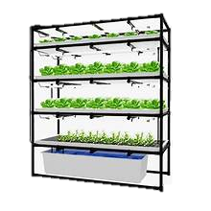
Conclusion
The automated hydroponic cattle feed generator demonstrates a sophisticated embedded system. The project contributes to sustainable cattle feed production through precise timing, multi-motor control, sensor integration, and robust state-machine logic.

